Slide 1
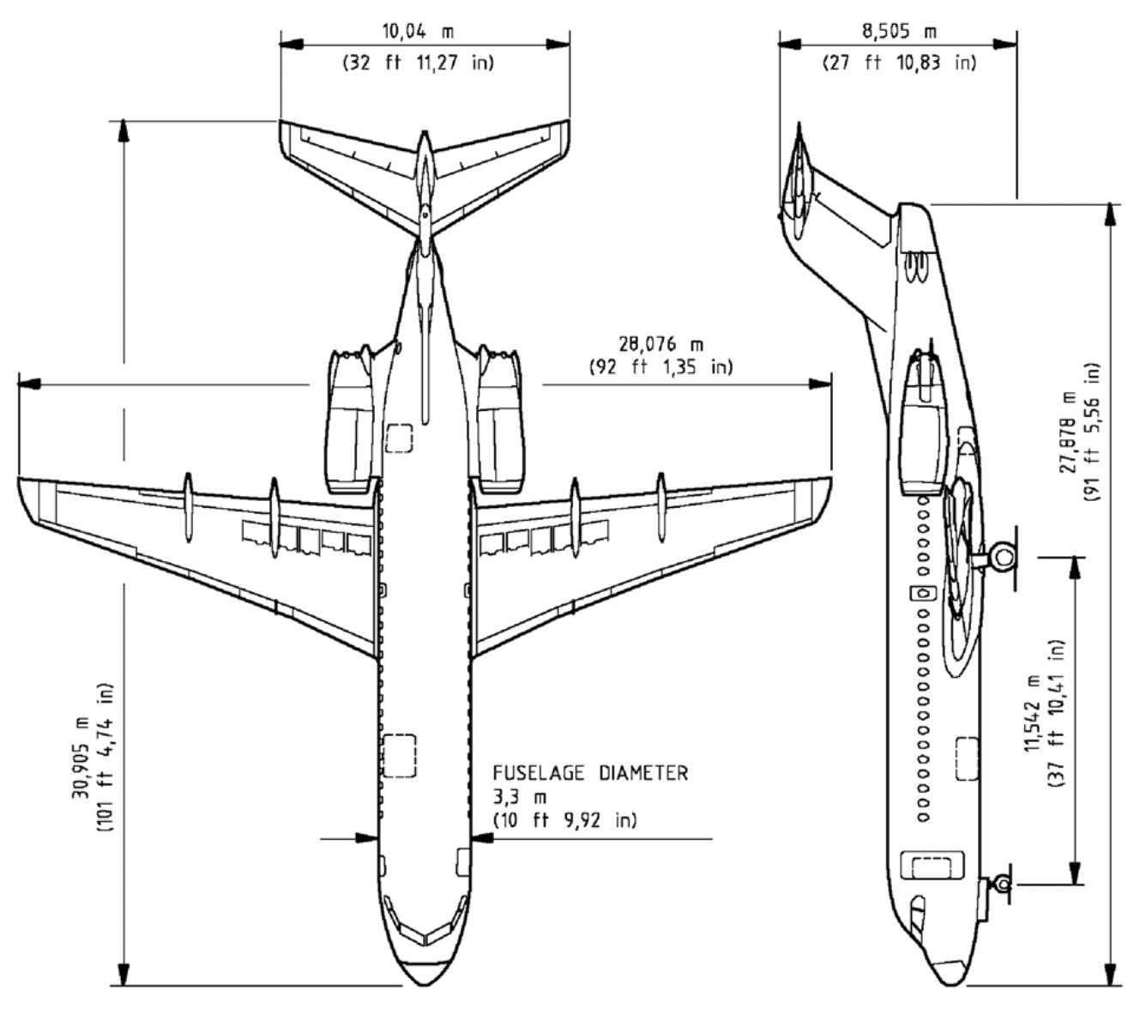
https://booksite.elsevier.com/9780340741528/appendices/data-a/table-8/table.htm
16.70 m
1.42m
Ratio = 30.905m/0.2357 = 1 : 131.12
23,57cm in PP
20.6 deg
9.31
13.20m
4.16 m
25.5 deg
4.73m
5.41 m
10.94 m
6.05 m

Slide 2
https://booksite.elsevier.com/9780340741528/appendices/data-a/table-8/table.htm
5.74 m
1.48m
Ratio = 30.905m/0.2357 = 1 : 131.12
20.6 deg
9.86
2.16
4.16 m
4.79m
25.5 deg
6.05 m

Slide 3
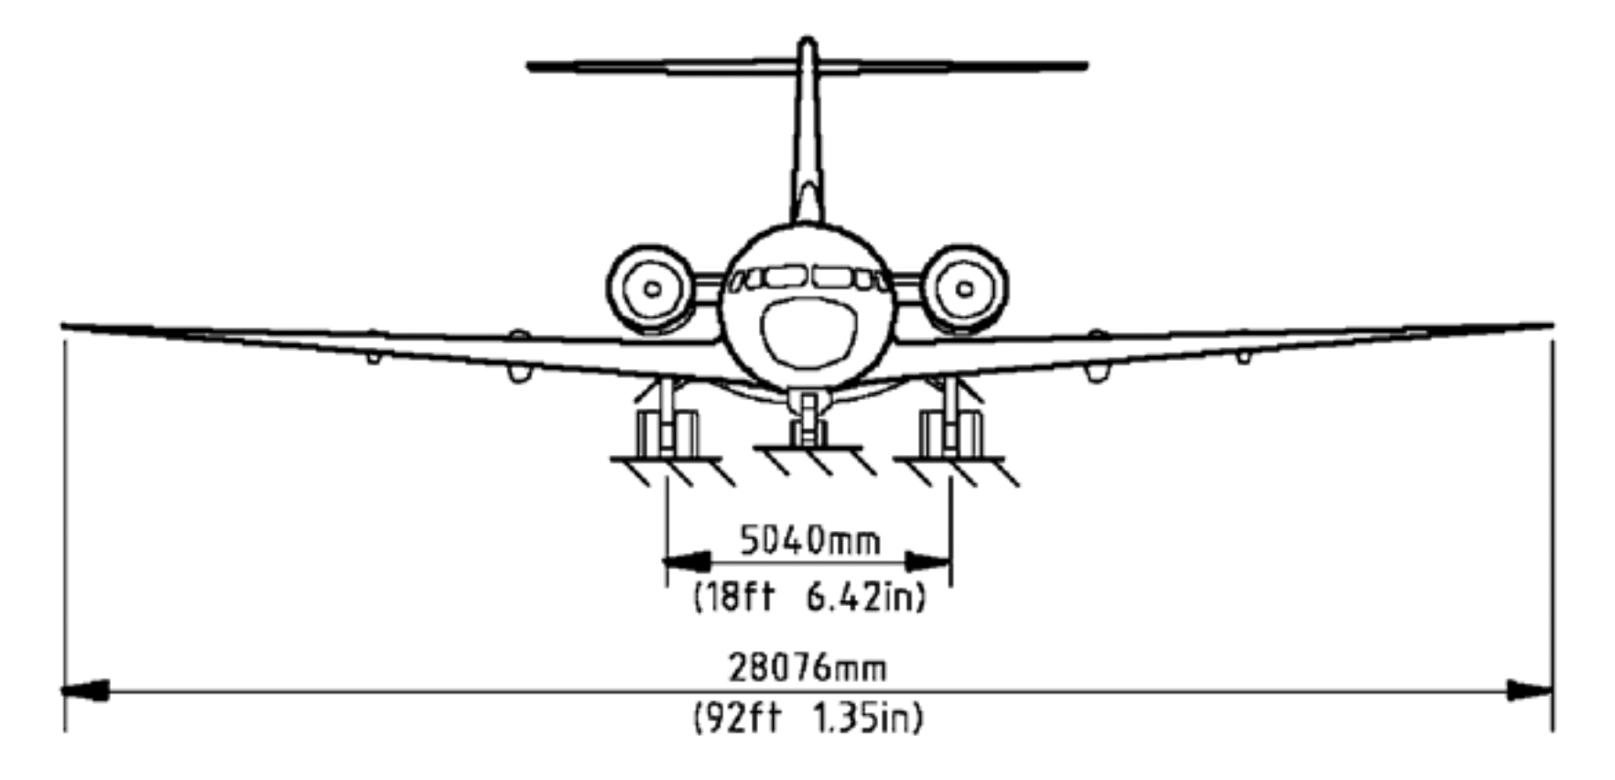
Ratio = 1 : 60.76
3 degrees dihedral
0.698 m
1.184 m
0.450 m

Slide 4
